Slide 1

Source Control using GitHub
Hayden Do

Slide 2
Learning Outcomes
Understand the benefit of using git
Be able to make clones, commit changes and resolve conflicts using git
Aware of what branches are and why they are important
Notes:
Explain the backend code here

Slide 3


Slide 4

Source Control
Management of codebase by recording changes to code over time (like a snapshot)
Collaborate with team or members of the community
Git
Team Foundation Server (TFS)
Subversion

Slide 5
Basic Concepts
A repository:
Folder that you tell git to track changes
Maintains commits (snapshots) of the codebase (through diffs and file versions)
Allows you to revert to any previous commit or branch (set of commits)
Work locally, then pull and push from a central repository (GitHub)

Slide 6
What you need to use GitHub
Install Git (https://git-scm.com/)
Create a GitHub Account (https://github.com/)

Slide 7
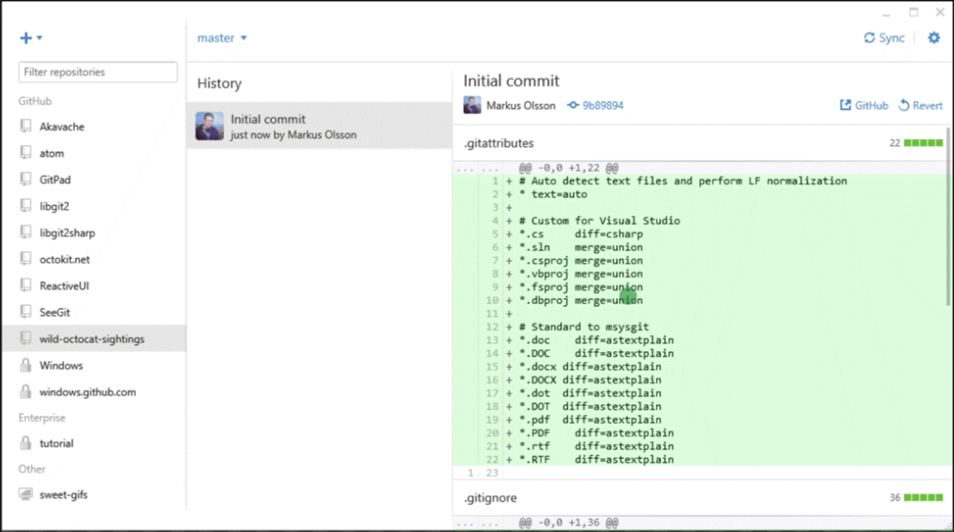
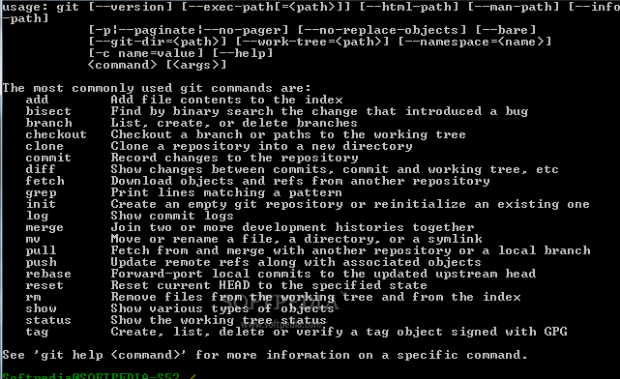
GitHub GUI vs CLI
You can do basic operations with the GUI
But you should know how to use CLI (in case the repo goes into a weird state)

Slide 8
Basic Git Commands
git clone https://github.com/.....
git status
git add –A
git commit –m “Message Here”
git pull
git push
git branch [branch name]
git checkout [branch name]
git merge [branch name]

Slide 9

DEMO
Create a new repository
Add files to repo
Commit / Push / Pull
Conflicts
Branch + Pull Request

Slide 10
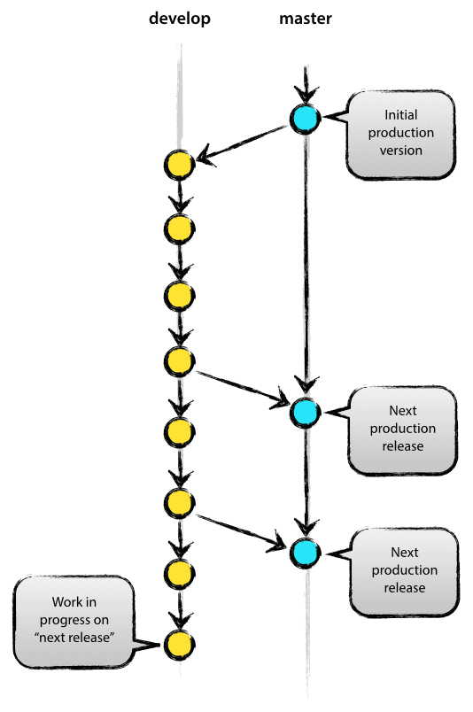
Main Branches
Two branches develop, master
When code in develop become stable, all changes are merged back to master
A merge back into master is considered a new production release
Source: http://nvie.com/posts/a-successful-git-branching-model/

Slide 11
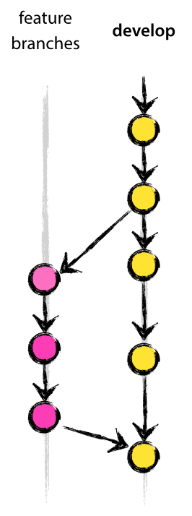
Supporting Branches
New branch for each feature
Makes it easier to revert a whole feature
Ensure completeness before merging
Finished features may be merged back into develop branch for upcoming release
Source: http://nvie.com/posts/a-successful-git-branching-model/

Slide 12
In Summary
Understand the benefit of using git
Be able to make clones, commit changes and resolve conflicts using git
Be able to create branches and understand why they are important

